Slide 1

AIR Quality Monitoring System
Vineeth Mathangi

Slide 2
B00828528 Mathangi-V@ulster.ac.uk
ULSTER UNIVERSITY.
JORDONSTOWN.
MSC -INTERNET OF THINGS

Slide 3
Problems :
Years ago pollution has become one of the major concern all over the world.
The pollution and heating rapidly raised to 0.85c.Moreover at the end of the 2030 it was predicted to be over 20,00,000 deaths around the world.
At present heating of oils ,fuels and plastics are leads to the critical climatic changes and in pollution as well.
Big concern is, it can impact the health of the crops may lead to the reduction of the food sources and other related health issues. For instance, Ozone is one of the most affective air pollutants to ecosystems and to crops.
However it acts as oxidants, in atmosphere surface level the plays secondary pollutant eventually it creates the oxidation of NO2.The below figure shows the difference between normal leaf and affected leaf

Slide 4
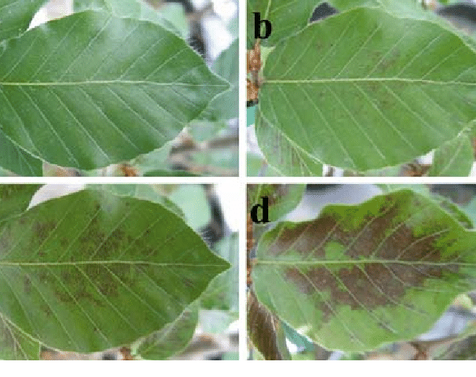
However it acts as oxidants, in atmosphere surface level the plays secondary pollutant eventually it creates the oxidation of NO2.The below figure shows the difference between normal leaf and affected leaf.
when the quantity of the pollutant enters into the human body it slowly effects on the respiratory system and creates infectious diseases or may directly lead to the damage in lungs. these toxics can simply enter and spread all over the body leads to death.

Slide 5
Literature :Yu and Lin [36] designed and constructed an intelligent wireless sensing and control system to deal and help with health problems caused by Air pollution. This complete system is depends upon 3 different parts:1)Data acquisition.2)Data analysis 3)data feedback.
. 1) Data Acquisition : it helps in obtaining the environmental indicators values likeRH , CO2 concentration and temperature through polling mechanisms.
2) Data Analysis: this section is good for collection of data samples and interfacing with Auto regressiveintegrated moving Average(ARIMA) prediction model for analysing the different kind of trends in the vicinity.
3 )Data feedback: it plays an important role,based on the results,action will be taken.however,it sends a warning message or may controls the fan speed automatically. In this architecture hardware is powered by IEEE1451.4 standard and also the communication channel is well established by Zigbee technology.

Slide 6
The software architecture is also perfectly separated as hardware into three different sections they are:
1):Data Monitoring : in this area agent creates a bridge between hardware and software ,for purpose of great communication.
2):Air quality Analyzing:here the agent particular about air quality trends and the higher pollution levels.lastly,
3):Application:In this area the agent gives services for the control and alerts for data display.
The final ARIMA model Air Quality monitoring system was deployed in the real-time environment. The performance of the system was later tested using two types of tests:

Slide 7
The final ARIMA model Air Quality monitoring system was deployed in the real-time environment. The performance of the system was later tested using two types of tests: :
1)Validation of the accuracy of the prediction model
2) validation of energy-saving performance.
The system used to make useful decisions about ventilation equipment in the surroundings depending upon the lowerlimit level of air quality parameters.
Reference:
A comprehensive review on indoor air quality monitoring systems for enhanced public health
“A comprehensive review on indoor air quality monitoring systems for enhanced public health | Sustainable Environment Research | Full Text (biomedcentral.com)”

Slide 8
Developed Solutions For hardware:
The Air Quality Monitoring System (AQMS) is a facility to measure wind speed, direction, other weather parameters, concentration of air pollutants (such as SO2, NOx, CO, O3, THC etc), and particulate matters continuously all year round. Mobile AQMS can also be customized to monitor multiple sites via one system.
The measured data can be remotely monitored and exported in various formats to the local central authorities. The data can be published via the Internet for easy public access to raise awareness on current air pollution levels.
This way, the public can prevent outdoor activities and reduce health impacts during heavy polluted days.

Slide 9
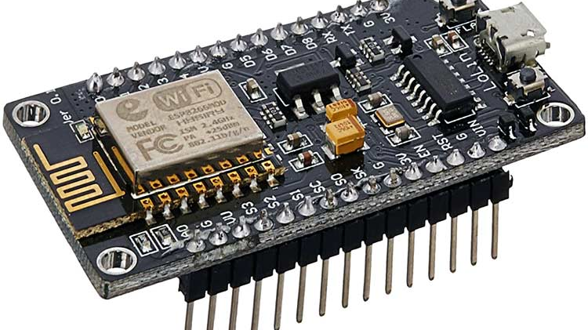
In this project Im are going to make an IoT Based Air Pollution/Quality Monitoring System with ESP8266 (Nodemcu), MQ-135 Air Quality Sensor DHT11 Sensor. We will monitor the Air Quality on Thinspeak Server using the internet.
Following are the components required for making IoT-based Air Pollution/Quality Monitoring System
NODEMCU (ESP-8266):
NodeMCU is an open source firmware for which open source prototyping board designs are available. The name "NodeMCU" combines "node" and "MCU" (micro-controller unit). The term "NodeMCU" strictly speaking refers to the firmware rather than the associated development kits.

Slide 10
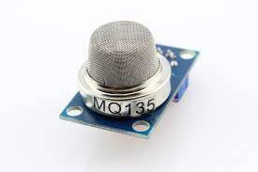
MQ-135 gas sensor: The MQ-135 gas sensor senses the gases like ammonia nitrogen, oxygen, alcohols, aromatic compounds, sulfide and smoke. sensor increases as the concentration of polluting gas increases. MQ-135 gas sensor can be implemented to detect the smoke, benzene, steam, and other harmful gases. It has the potential to detect different harmful gases.

Slide 11
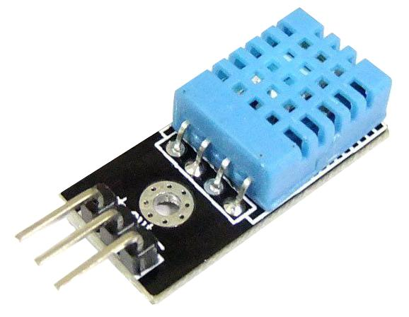
The DHT11 is a basic, ultra low-cost digital temperature and humidity sensor. It uses a capacitive humidity sensor and a thermistor to measure the surrounding air, and spits out a digital signal on the data pin (no analog input pins needed). Its fairly simple to use, but requires careful timing to grab data.

Slide 12

Description of Data:
After making the prototype data has to be collected or monitored.Moreover with the help of the Thingspeaks we can monitor the data
Thingspeak one of the best platform for making projects and it acts as cloud ans stores the data.

Slide 13
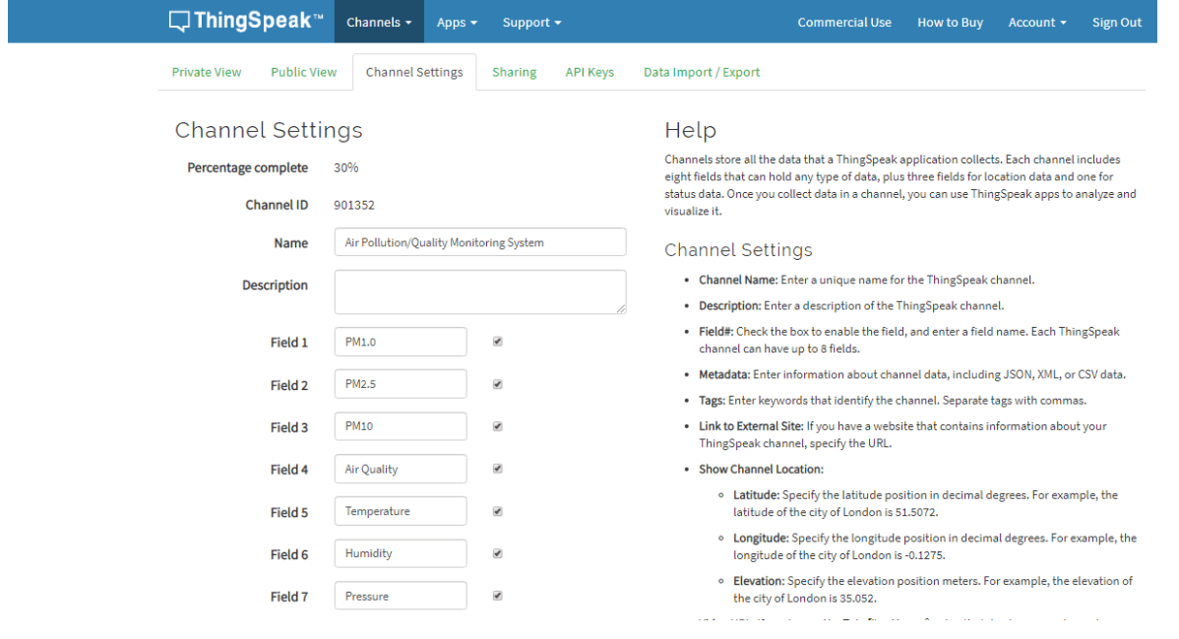
Click on the channel provided and new channel provides the fields which will help to monitor

Slide 14
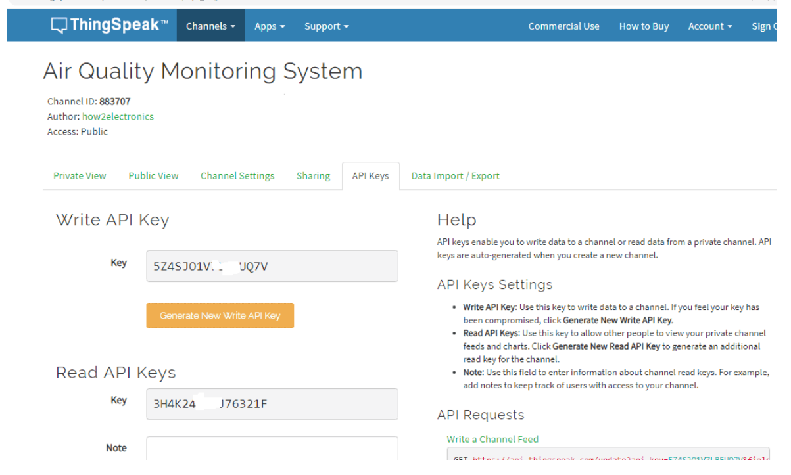
Save the write API key and paste it in Arduino code which helps to link the server of Thingspeak.

Slide 15
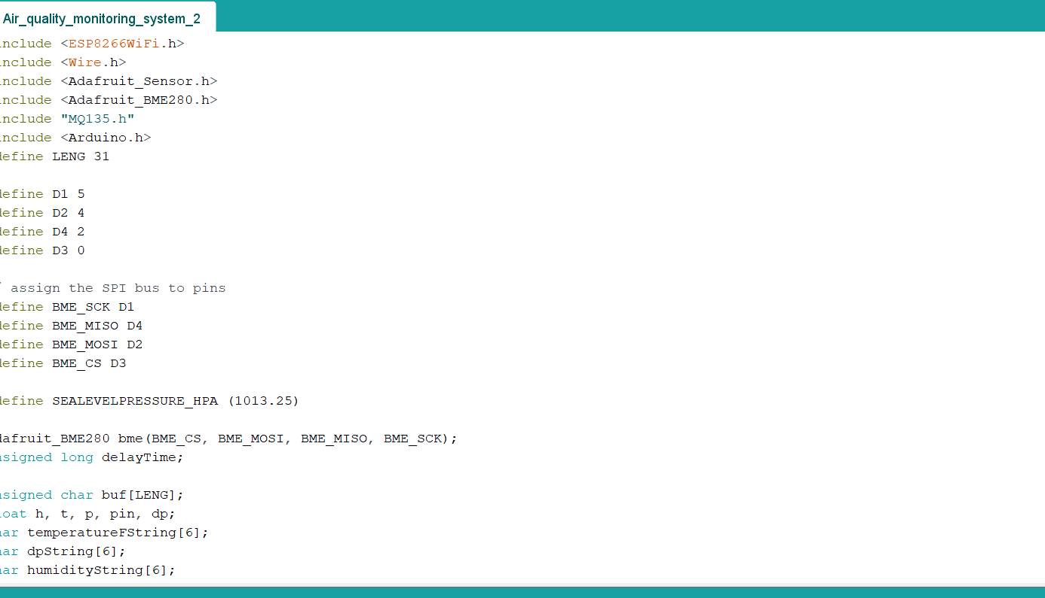
With the help of the API key ,connected to the server of Thingspeak.moreover,SSID and password need to given for connecting to wifi.

Slide 16
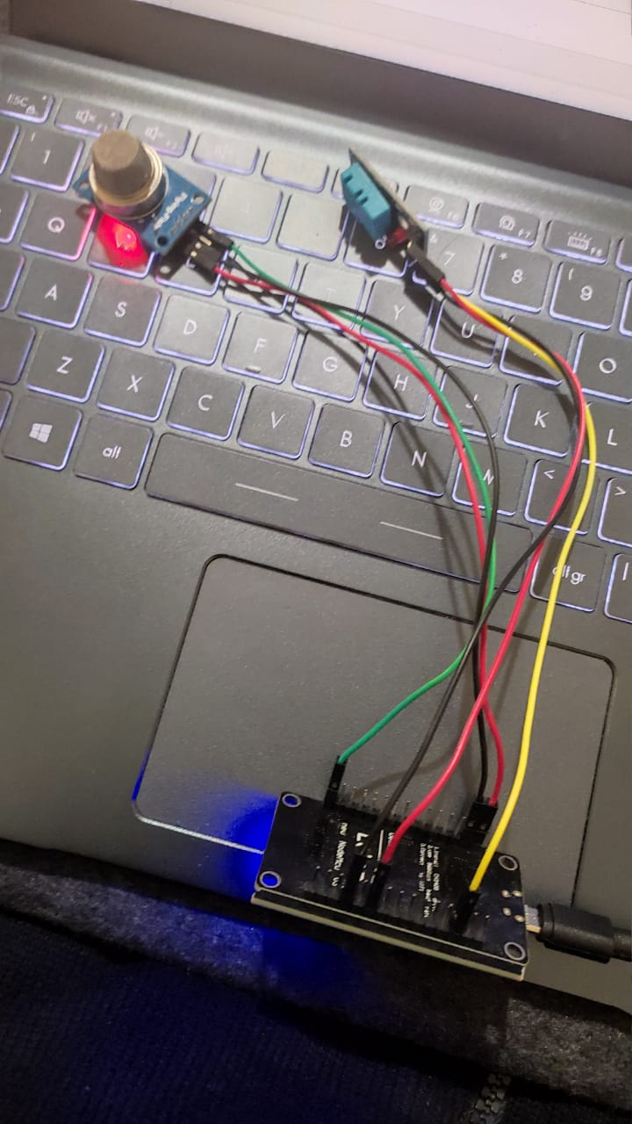
Demo of the project: Node mcu was connected to the pc and then with Arduino code it will connects to the Thingspeak server. And readings can be monitored in the server of thingspeak. And also we can collect the data

Slide 17
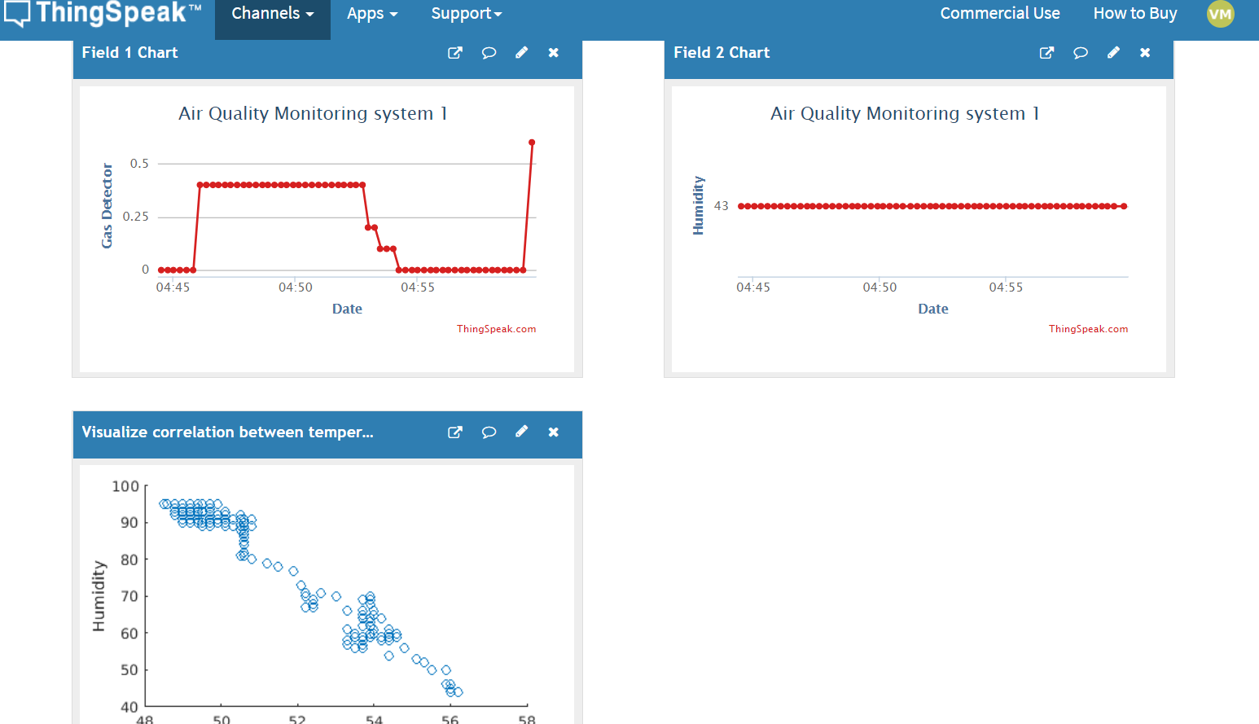
Complete readings of the gas and humidity sensors with readings

Slide 18
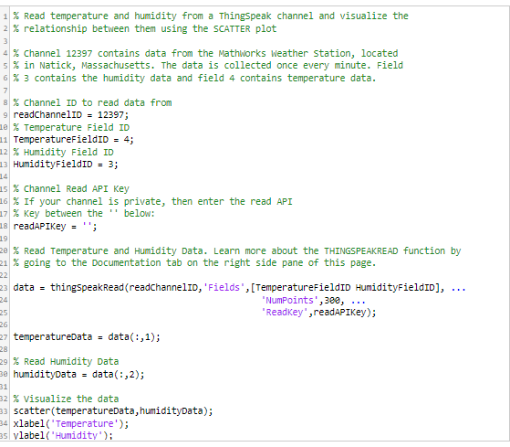
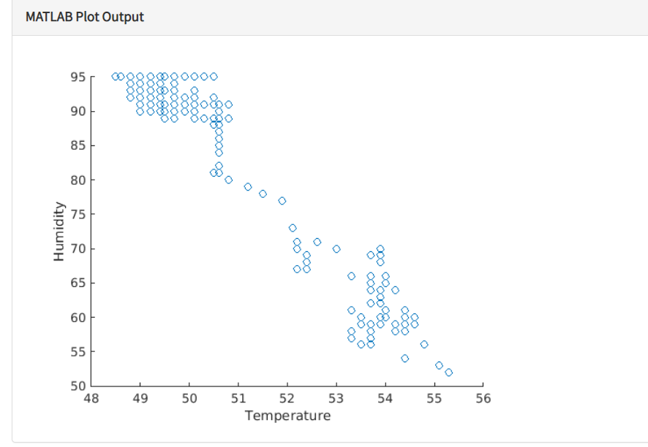
data visualization of temperature using matlab:

Slide 19
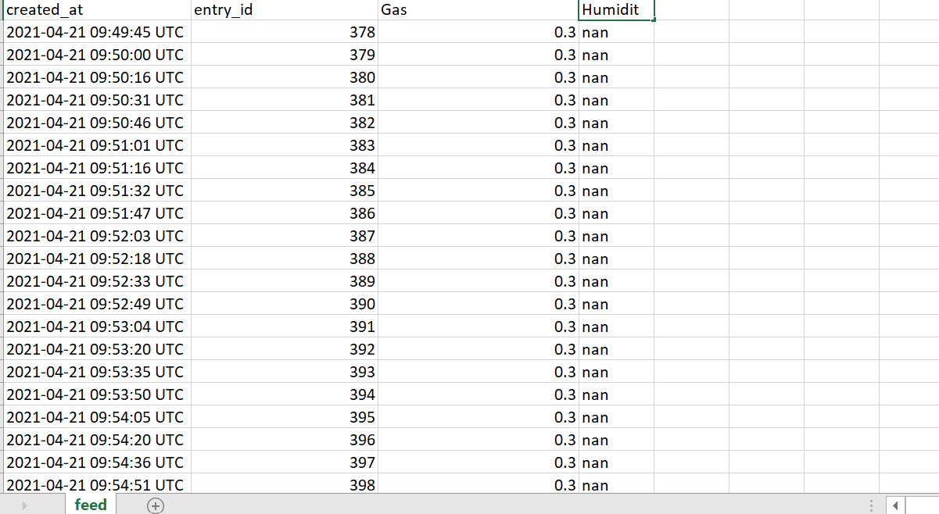
Complete CSV file (datasets) of both gas and humidity.

Slide 20
Critical evaluation :
The AQM has been called into question since it came in to picture and a broad consensus amongst the air quality community is that these plans are not sufficient to address the public health challenge in as short a time as possible .
The lack of transparency within the consultation process, particularly regarding the data used to estimate the rate of vehicle fleet turnover reduces the confidence of stakeholders in the AQM of the plan.
It is also concerning that a widely held view of a lack of transparency within the plan was not properly reported in the summary of consultation responses and raises the possibility .
that these widely held views have not been considered thoroughly in the final AQM.

Slide 21
Conclusion:
To be concluded, this topic completely discussed on the challenges, literature and some of the prototypes of Air quality monitoring using Pervasive computing. In addition, the development of an IoT-based indoor air quality monitoring platform is presented. Experiments were performed to verify the air quality measurement device. Also, experiments making use of the platform were conducted and demonstrated suitable performance and convenience of the air quality monitoring platform. Several achievements of the platform were accomplished, indoor air quality can be efficiently monitored anywhere and in real time by using an IoT and a cloud computing technologies like Thingspeak. Future work will involve further testing of the device and the platform and came to know that AQM is one of the best and less effective prototype where shaping the future will be easy using by pervasive computing.

